Slide 1

Second review
Predictive Modelling of Fitness Goal Achievement Using Machine Learning and Real-Life User Training Data
Reg. No: RA2211028010063
Name: Mohammed Lamih Reg. No: RA2211028010085
Name : Nishith Kashimalla Reg. No: RA2211028010171
Name: Y. Yaswanth
Guide name: Dr. Vaddi Venkata Narayana Designation: Assistant Professor Department: Networking and Communications

Slide 2
ABSTRACT
Current fitness programs often rely on generic workout and nutrition plans without considering individual
differences such as body composition, metabolism, lifestyle, and health conditions.
Despite the growth of digital fitness platforms and wearable devices, the large amount of generated user data is not effectively used for personalized recommendations.
This results in inconsistent training, slow progress, reduced motivation, and potential health risks for individuals aiming to achieve fitness goals.
Therefore, there is a need for an intelligent machine learning–based system that analyzes user data to provide personalized workout and nutrition recommendations.

Slide 3
PROBLEM STATEMENT
Many existing fitness programs rely on generic workout routines and nutrition plans that do not
consider individual differences such as body composition, metabolism, lifestyle, and health conditions,
making it difficult for users to achieve their specific fitness goals effectively. Although digital fitness platforms and wearable technologies generate large volumes of user health and training data, this data is often underutilized and not intelligently analyzed to provide personalized fitness recommendations. As a result, individuals aiming for weight loss, muscle gain, endurance improvement, or overall wellness may experience inconsistent training guidance, slow progress, and reduced motivation, while ineffective workout and nutrition planning can lead to physical strain, nutritional imbalance, decreased performance, and potential long-term health risks.

Slide 4
INTRODUCTION
The increasing awareness of health, fitness, and lifestyle management has created a growing demand for intelligent systems that can provide personalized workout and nutrition recommendations.
This work focuses on developing an intelligent fitness goal achievement system that predicts suitable workout exercises and nutrition plans based on real-life user training data. By analyzing structured personal and physical attributes, the system generates tailored recommendations aligned with individual objectives such as weight loss, muscle gain, endurance improvement, or general wellness. The platform emphasizes personalization, accuracy, and practical usability.
By combining predictive intelligence with a user-friendly web interface, the system supports informed decision-making and promotes consistent fitness progress. The overall framework contributes toward smarter digital health solutions that bridge the gap between data analysis and personalized fitness planning.

Slide 5
LITERATURE SURVEY
S. No | Title | Methodology | Accuracy/Result | Identification of Gaps and Limitations
1 | Enhancing Fitness Action Recognition with ResNet- TransFit: Integrating IoT and Deep Learning Techniques for Real-Time Monitoring - Zheng Li, Yifan Zhang, Haoran Wang, et al. Alexandria Engineering Journal (Elsevier), 2024 | A hybrid ResNet-TransFit architecture combined ResNet for spatial feature extraction and Transformer for temporal sequence modeling. | The hybrid model achieved 93.7% accuracy, 48.5 ms latency, and 29.1 fps throughput | The architecture exhibits high computational complexity and memory consumption, limiting deployment on resource- constrained devices.
2 | Construction of Sports Training Performance Prediction Model Based on a Generative Adversarial Deep Neural Network Algorithm- Jianhua Liu, Xiaoyan Wang, Yong Chen, Computational Intelligence and Neuroscience (Hindawi/Wiley), 2022 | A multigenerative adversarial deep neural network with reconstruction sampling enhanced gradient stability and reduced training time. | Reconstruction sampling effectively mitigated gradient vanishing and accelerated convergence. Attention weighting enhanced feature discrimination, leading to more reliable sports performance prediction and demonstrating superiority over baseline deep learning approaches. | Real-time deployment feasibility was not fully validated, and comparison with lightweight or traditional machine learning models was insufficient for assessing efficiency trade-offs.

Slide 6
LITERATURE SURVEY
S. No | Title | Methodology | Accuracy/Result | Identification of Gaps and Limitations
3 | Keeping People Active and Healthy at Home Using a Reinforcement Learning-based Fitness Recommendation Framework- Tomasz Wozniak, Dietmar Jannach, Paul Resnick, Proceedings of IJCAI (International Joint Conference on Artificial Intelligence), 2023 | A reinforcement learning framework generated sequences of bodyweight exercises through a neural network trained with a user simulator. | The reinforcement learning approach demonstrated significantly higher engagement compared with the baseline recommender during the 15-week deployment. | The participant pool and exercise types were limited, reducing generalizability. Long-term sustainability beyond the trial duration and energy consumption on mobile devices were not thoroughly examined.
4 | Dynamic Physical Activity Recommendation Delivered through a Mobile Fitness App: A Deep Learning Approach - Vairavasundaram Subramaniyaswamy, Varadarajan Vijayakumar, Srinivasan Deepthi, et al. Srinivasan Deepthi, et al., Axioms (MDPI Journal), 2022 | A two-level clustering framework grouped users using physiological attributes and historical step patterns from 533 participants. Random Forest classified users with partial and complete features, while spline fitting supported pattern extraction. | The LSTM predictor achieved the highest accuracy of about 97.8%, outperforming SVM, RNN, and Random Forest. Classification with complete features reached 0.97 accuracy, while partial-feature classification achieved 0.82. | Heavy dependence on step- count data overlooks other activity modalities. Privacy and security considerations of continuous monitoring were minimally discussed, and computational overhead of deep learning models may affect low-end mobile device performance.

Slide 7
LITERATURE SURVEY
S. No | Title | Methodology | Accuracy/Result | Identification of Gaps and Limitations
5 | Physical Activity Monitoring and Classification Using Machine Learning Techniques -Saeed Ali Alsareii, Muhammad Awais, Abdulrahman Manaa Alamri, et al. Life (MDPI Journal), 2022 | Wearable smartphone sensors collected triaxial accelerometer and gyroscope signals from 30 participants performing daily activities. After preprocessing and feature extraction in time and frequency domains, multiple classifiers such as SVM, XGBoost, Gradient Boosting, CatBoost, and AdaBoost variants were trained under balanced and intentionally imbalanced data distributions to evaluate sensitivity to class imbalance. | All classifiers achieved strong recognition performance, with weighted SVM delivering the best accuracy above 96% on balanced data and maintaining above 80% under imbalance. | Deep learning approaches were not explored, and the sample size was relatively small, which may restrict scalability and robustness across diverse activity patterns.

Slide 8
DATASET DESCRIPTION
Dataset: Fitness Goal Achievement Dataset
Source: KaggleLink:https://www.kaggle.com/datasets/ayyappanmarimuthu/fitness-goal-achievement-dataset
Description:
dataset contains user lifestyle and fitness related attributes.
Includes features such as age, gender, workout frequency, diet type, sleep duration, and calorie intake.
Helps analyze behavioural patterns affecting fitness goal achievement.
Used to train machine learning models to predict whether a user can achieve their fitness goals.

Slide 9
DISADVANTAGES OF EXISTING SYSTEM
Existing systems mainly emphasize activity monitoring and health risk detection, lacking comprehensive personalization for both workout exercises and nutrition planning within a single integrated and interactive digital environment for individual fitness goal achievement.
Many platforms depend heavily on wearable sensor data, limiting accessibility for users without specialized devices and reducing inclusivity in broader populations seeking personalized fitness guidance.
Interpretability mechanisms are often limited, providing predictions or classifications without detailed explanations, which may reduce user trust and hinder informed decision-making regarding fitness and lifestyle adjustments.
Integration between monitoring, prediction, and user interaction components is frequently fragmented, resulting in separate analytical outputs rather than a unified system delivering complete, goal-oriented fitness recommendations.

Slide 10
PROPOSED SYSTEM
The system introduces an intelligent predictive framework designed to generate personalized workout exercises and nutrition
plans using supervised machine learning techniques. It incorporates multiple classification models, including Random Forest, Decision Tree, K-Nearest Neighbors, XGBoost, CatBoost, and a Voting Classifier ensemble that combines diverse learning
strategies to enhance prediction robustness.
LIME is employed to provide local explanations for individual predictions by identifying influential features, while SHAP offers global feature contribution analysis to improve transparency and trust in recommendation outputs. For real-time accessibility and user interaction, a web-based interface is developed using the Flask framework with secure user authentication supported by SQLite.
The application collects user inputs, processes them through the trained models, and delivers categorized workout and nutrition recommendations. This integrated framework ensures intelligent prediction, interpretability, and practical deployment within a unified fitness recommendation environment.

Slide 11
ADVANTAGES OF PROPOSED SYSTEM
The system delivers comprehensive personalization by predicting both workout exercises and nutrition plans, ensuring holistic fitness guidance aligned with individual physical characteristics and lifestyle goals within a single unified platform.
It integrates multiple classification strategies within an ensemble framework, enhancing prediction robustness and ensuring consistent performance across diverse user profiles and fitness objectives.
Explainable AI techniques provide transparent local and global feature insights, improving user trust, interpretability, and understanding of how recommendations are generated.
A web-based interface with secure authentication enables real-time accessibility, structured user interaction, and seamless deployment, ensuring practical usability without dependency on specialized wearable devices.

Slide 12
REQUIREMENTS
HARDWARE REQUIREMENTS
Operating System: Windows 10 (Min) and Above
Processor: i5 9th Gen and Above
RAM: 8GB (Min) – 16 or 32 Preferable
Hard Disk: Free space 100 GB (Min)
SOFTWARE REQUIREMENTS
Software: Anaconda (2023.03-1)
Primary Language: Python (3.10.9)
Web Framework: Flask
Development Environment: Jupyter Notebook
Database: Sqlite3
Front-End Technologies: HTML, CSS, JavaScript and Bootstrap4

Slide 13
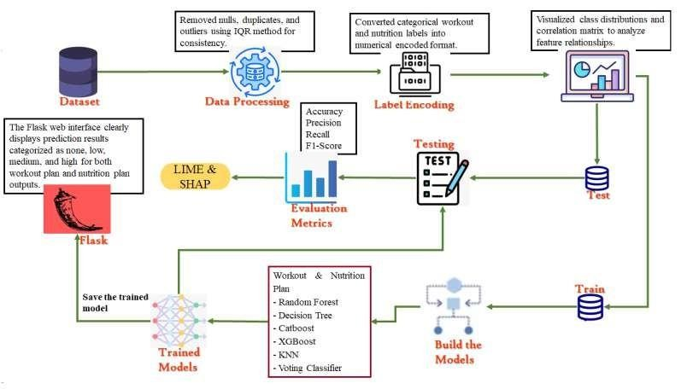
SYSTEM ARCHITECTURE

Slide 14
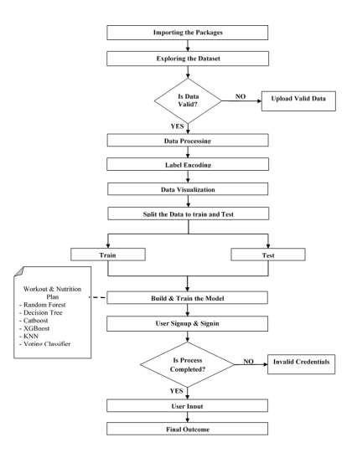
DATA FLOW DIAGRAM

Slide 15
UML DIAGRAMS

Slide 16
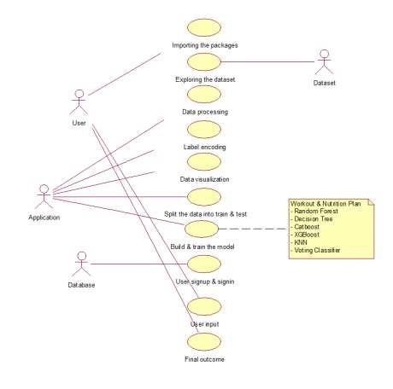
USE CASE DIAGRAM

Slide 17

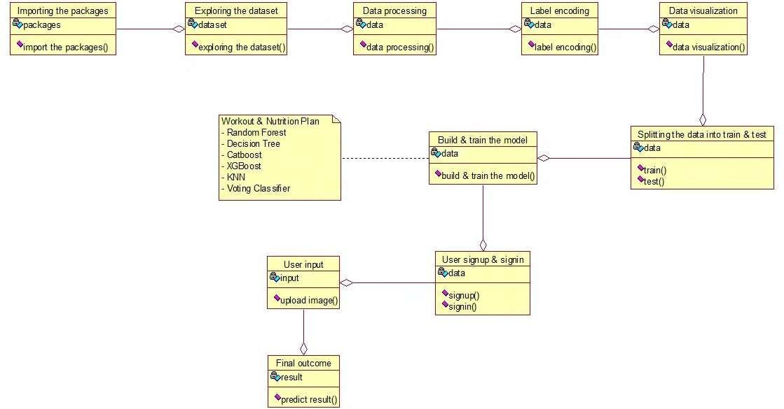
CLASS DIAGRAM

Slide 18
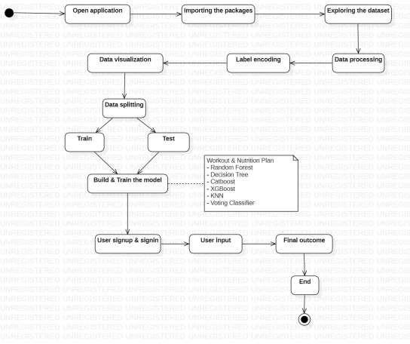
ACTIVITY DIAGRAM

Slide 19
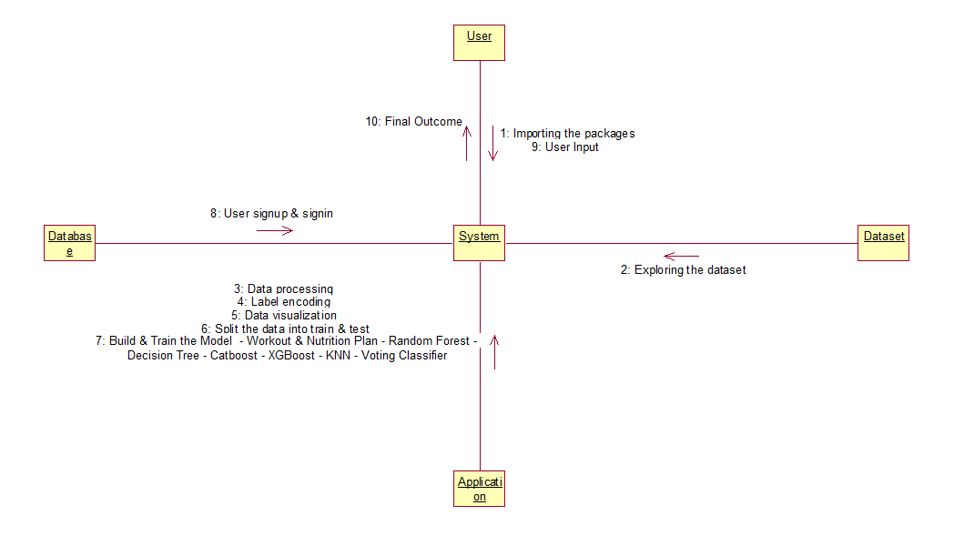
COLLABORATION DIAGRAM

Slide 20
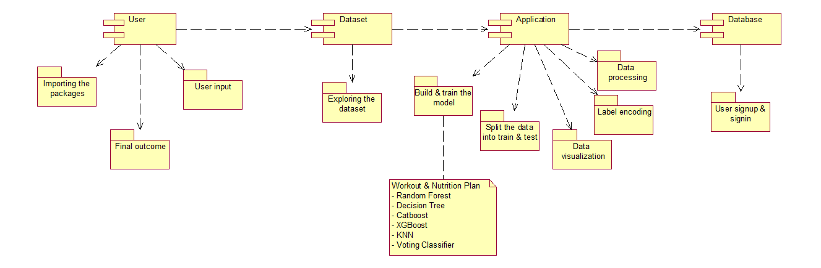
COMPONENT DIAGRAM

Slide 21
FLOW OF WORK/WORKING MODULES
Importing the Packages: Essential libraries are imported to support data manipulation, visualization, model development, evaluation, explainability, and web deployment. These include modules for numerical computation, data handling, plotting, preprocessing, machine learning models, ensemble techniques, model persistence, and interpretability tools, ensuring a complete and efficient implementation workflow.
Exploring the Dataset: The dataset is loaded and examined to understand its structure, feature names, data types, and target variables related to workout exercises and nutrition diets. Summary statistics, unique value counts, and sample records are reviewed to identify inconsistencies, class distributions, and potential data quality issues.
Data Processing: Data preprocessing involves removing null values and duplicate records to maintain data integrity. Outliers are detected and eliminated using the Interquartile Range method to reduce skewness and improve reliability. These steps ensure consistent, clean, and high-quality input for accurate prediction modeling.
Label Encoding: Categorical variables, including workout and nutrition targets, are transformed into numerical format using label encoding. This process converts textual categories into integer representations while preserving class distinctions, enabling compatibility with machine learning models that require numerical input features for training and prediction.

Slide 22
FLOW OF WORK/WORKING MODULES
Split the Data into Train and Test: The dataset is divided into training and testing subsets for both workout and nutrition targets. The training set is used to learn patterns, while the testing set evaluates generalization performance. Proper splitting ensures unbiased validation and prevents information leakage during prediction assessment.
Model Training: Multiple models are trained, including Random Forest, Decision Tree, K-Nearest Neighbors, XGBoost, CatBoost, and a Voting Classifier combining Random Forest, Gradient Boosting, and XGBoost. Each model learns from processed data to predict suitable workout and nutrition plans effectively.
Evaluation: Model performance is assessed using accuracy, precision, recall, and F1-score to measure classification effectiveness for both targets. Comparative analysis and graphical representations are generated to identify the most reliable model, ensuring robust prediction capability and balanced performance across classes.
LIME and SHAP: Explainable AI techniques are implemented to interpret model predictions. LIME provides local explanations by highlighting influential features for individual predictions. SHAP delivers global feature importance and contribution analysis, enhancing transparency, trust, and understanding of personalized workout and nutrition recommendations.

Slide 23
FLOW OF WORK/WORKING MODULES
Flask Framework: A web application is developed using Flask to enable real-time prediction services. The framework handles routing, user interaction, backend communication, and model integration. It ensures seamless data transmission between interface and prediction module while supporting scalable and efficient deployment.
User Signup and Signin: User registration and authentication functionalities are implemented using secure credential storage in an SQLite database. Password hashing and validation mechanisms ensure data security. Successful authentication grants access to personalized prediction features within a protected and user-specific session environment.
User Input: The web interface collects structured fitness-related inputs such as age, weight, activity level, and goals. Input validation ensures completeness and correctness before transmission to the backend. The processed data is prepared and forwarded for prediction generation.
Final Outcome: The system generates personalized workout exercises and nutrition plans categorized into none, low, medium, or high suitability levels. Results are clearly displayed on the interface, enabling users to understand recommended intensity and dietary alignment tailored to their fitness objectives.

Slide 24
PERFORMANCE EVALUATION TABLES

Slide 25
WORKOUT PLAN
ML Model | Accuracy | Precision | Recall | F1-Score
Random Forest | 0.9685 | 0.9700 | 0.9685 | 0.9666
Decision Tree | 0.8375 | 0.8428 | 0.8375 | 0.8334
CatBoost | 0.9555 | 0.9584 | 0.9555 | 0.9554
XGBoost | 0.9770 | 0.9779 | 0.9770 | 0.9759
KNN | 0.3795 | 0.3403 | 0.3795 | 0.3415
Voting Classifier | 0.9940 | 0.9940 | 0.9940 | 0.9940

Slide 26
NUTRITION PLAN
ML Model | Accuracy | Precision | Recall | F1-Score
Random Forest | 0.9810 | 0.9818 | 0.9810 | 0.9804
Decision Tree | 0.9440 | 0.9456 | 0.9440 | 0.9436
CatBoost | 0.9410 | 0.9427 | 0.9410 | 0.9370
XGBoost | 0.9560 | 0.9579 | 0.9560 | 0.9533
KNN | 0.4420 | 0.3801 | 0.4420 | 0.3773
Voting Classifier | 0.9875 | 0.9876 | 0.9875 | 0.9874

Slide 27
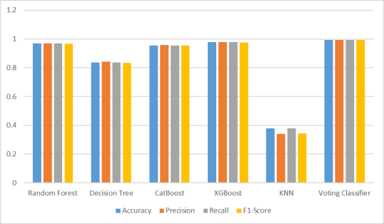
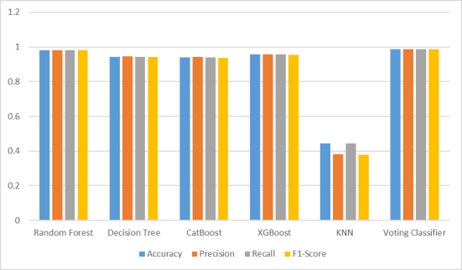
COMPARISON GRAPHS
Nutrition Plan
Workout Plan

Slide 28
EXECUTION

Slide 29
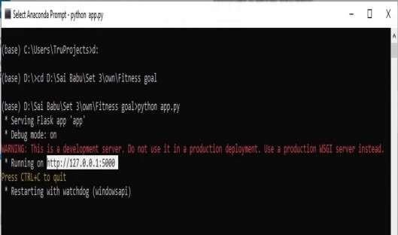
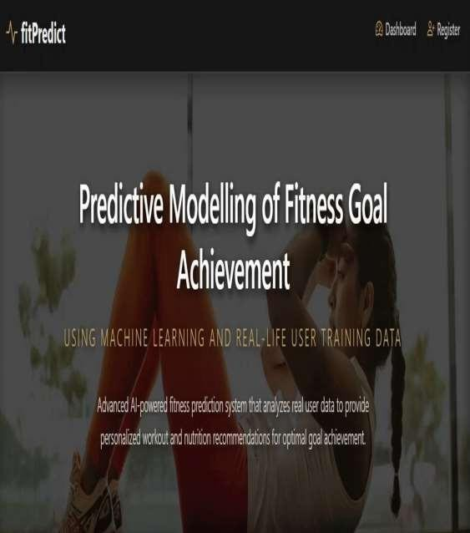

Slide 30



Slide 31
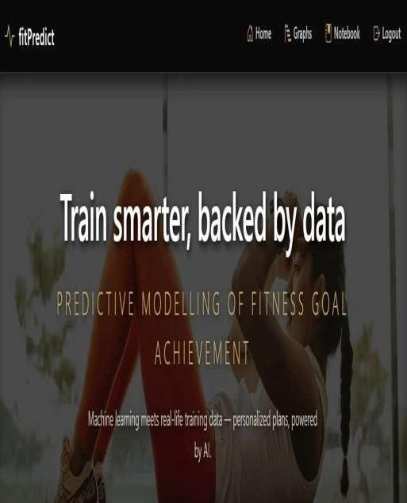
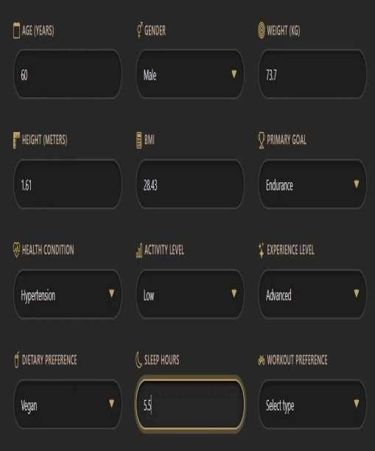

Slide 32

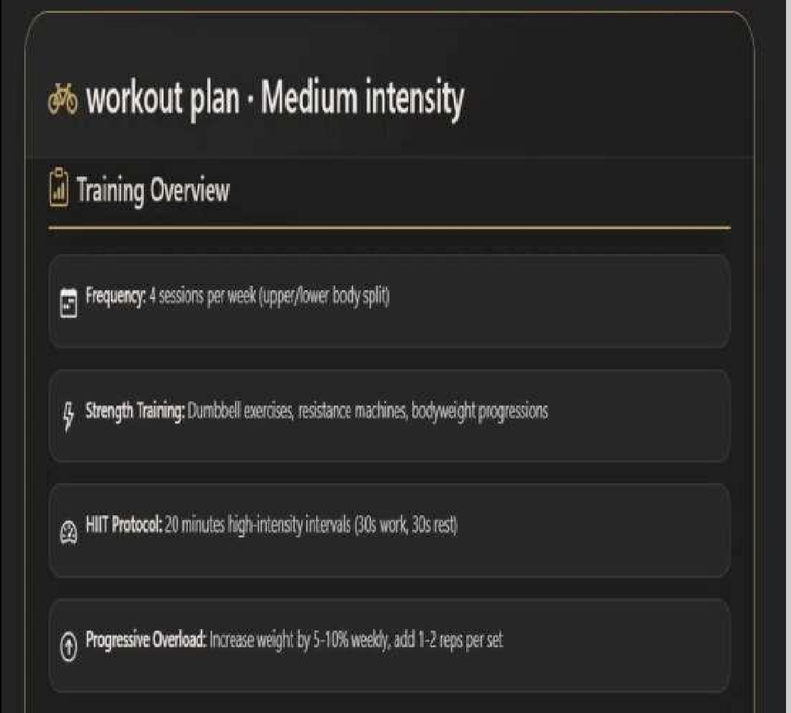



0urper/02t'Iiieï pIar

Slide 33
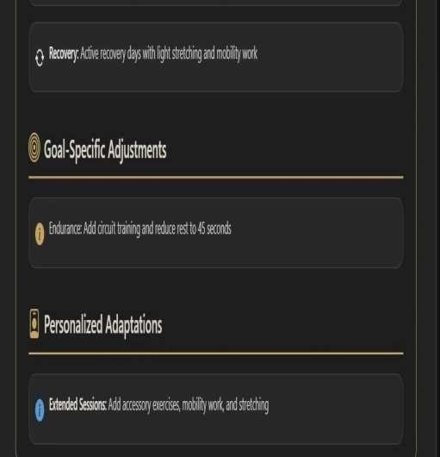
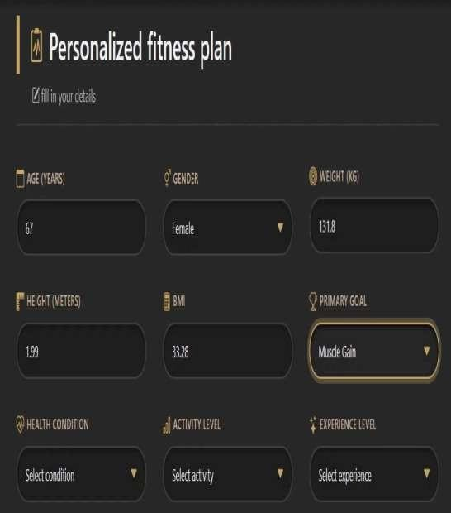

Slide 34
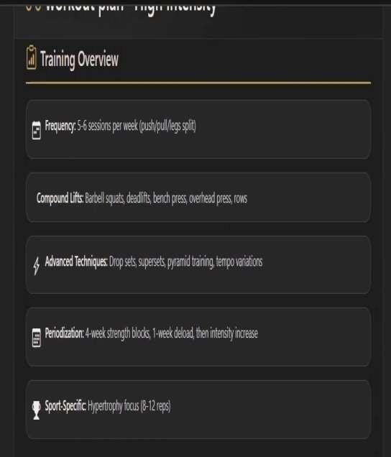
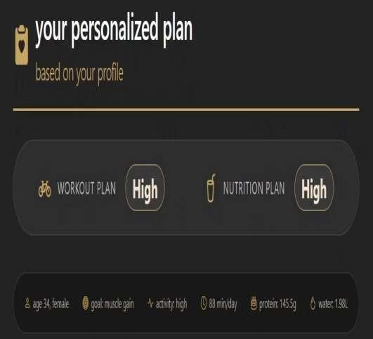

Slide 35

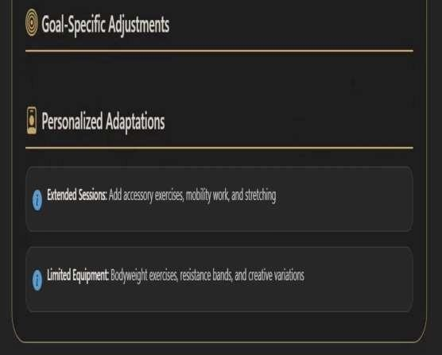

Slide 36
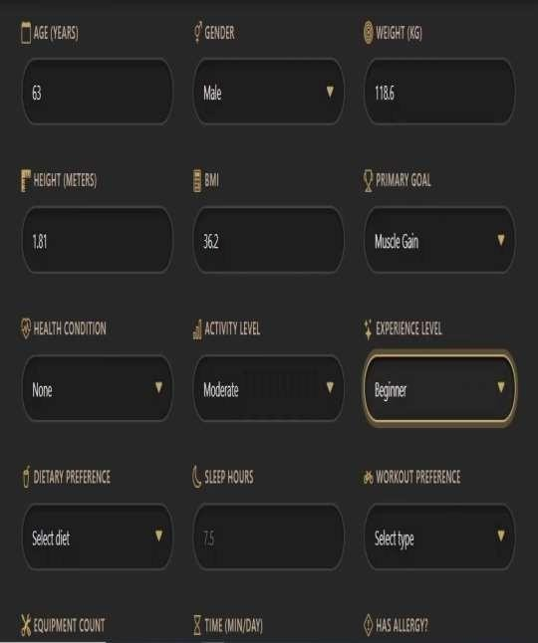
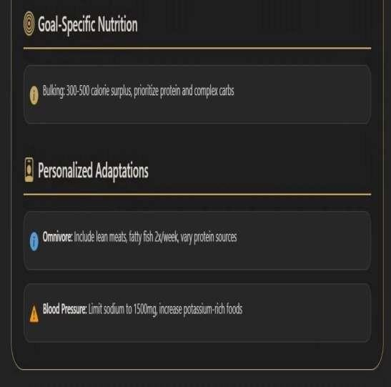

Slide 37
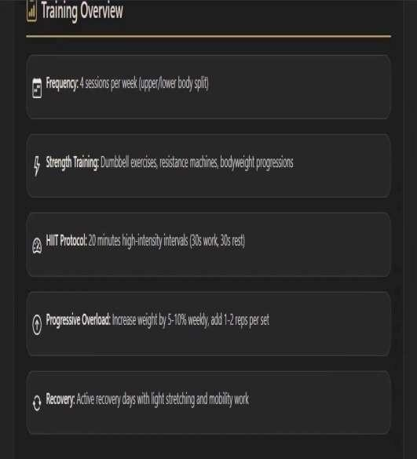
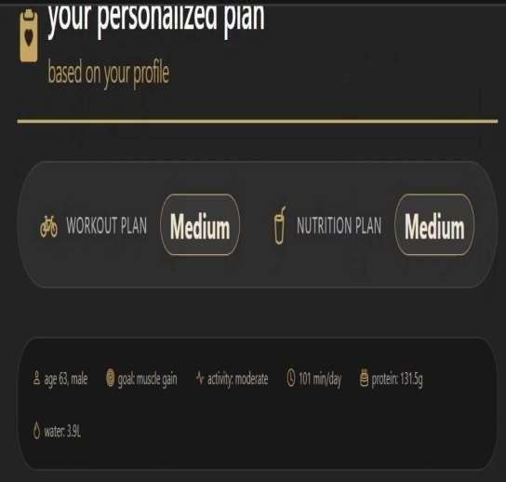

Slide 38

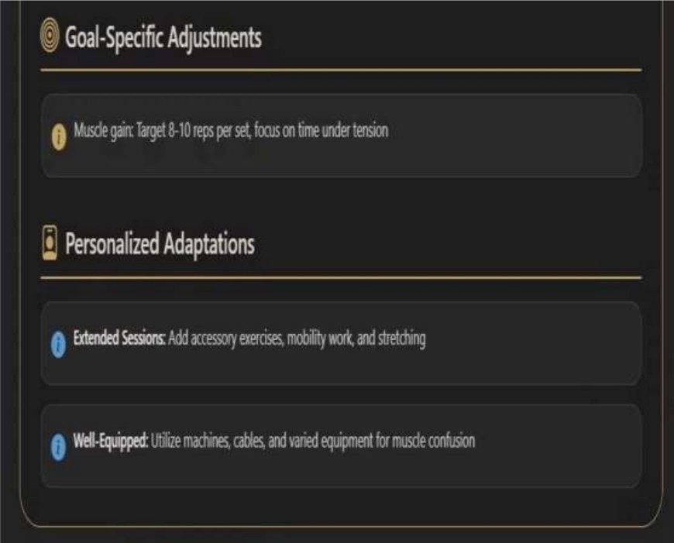

Slide 39
CONCLUSION
Accurate prediction of personalized workout and nutrition strategies significantly improves fitness goal attainment by aligning training recommendations with individual characteristics. The developed machine learning framework successfully models dual targets—Workout Plan and Nutrition Plan—using structured real-life fitness data with comprehensive preprocessing, outlier handling through IQR, and label encoding. Comparative evaluation of Random Forest, Decision Tree, KNN, XGBoost, CatBoost, and an ensemble Voting Classifier demonstrates that ensemble learning provides superior generalization performance.
The Voting Classifier achieved the highest accuracy of 99.40% for Workout Plan prediction and 98.75% for Nutrition Plan prediction, outperforming XGBoost and Random Forest across precision, recall, and F1-score metrics. These results confirm the effectiveness of hybrid ensemble strategies for multi-target fitness recommendation tasks.
Model transparency is ensured through Explainable Artificial Intelligence techniques, where LIME provides local interpretability for individual predictions and SHAP delivers global feature contribution analysis, improving trust and decision reliability. Deployment through a Flask-based web application with SQLite integration enables secure user interaction, real-time inference, and scalable implementation.
The overall outcome demonstrates a robust, interpretable, and high-performance predictive framework capable of delivering personalized fitness recommendations with practical real-world applicability.

Slide 40
FUTURE SCOPE
Future enhancements can focus on integrating real-time wearable sensor data such as heart rate variability, sleep patterns, step count, and calorie expenditure to improve dynamic fitness recommendation accuracy.
Incorporating deep learning architectures, including LSTM and Transformer-based models, may further capture temporal dependencies in user activity patterns. Expanding the dataset to include diverse demographic and clinical profiles would improve generalizability across broader populations.
Multi-objective optimization techniques can be explored to simultaneously balance fitness effectiveness, injury prevention, and nutritional adequacy. Additionally, reinforcement learning could be adopted to adapt recommendations based on continuous user feedback.
Deployment scalability can be enhanced through cloud-native architectures and RESTful APIs, while federated learning approaches may be considered to ensure privacy-preserving model updates across distributed user environments.

Slide 41
REFERENCES
Alsareii, S. A., Awais, M., Alamri, A. M., AlAsmari, M. Y., Irfan, M., Aslam, N., & Raza, M. (2022). Physical activity monitoring and classification using machine learning techniques. Life, 12(8), 1103.
Vairavasundaram, S., Varadarajan, V., Srinivasan, D., Balaganesh, V., Damerla, S. B., Swaminathan, B., & Ravi, L. (2022). Dynamic physical activity recommendation delivered through a mobile fitness app: a deep learning approach. Axioms, 11(7), 346.
Tragos, E. Z., O'Reilly-Morgan, D., Geraci, J., Shi, B., Smyth, B., Doherty, C., ... & Hurley, N. (2023, August). Keeping People Active and Healthy at Home Using a Reinforcement Learning-based Fitness Recommendation Framework. In IJCAI (pp. 6237-6245).
Li, G. (2022). Construction of sports training performance prediction model based on a generative adversarial deep neural network algorithm. Computational Intelligence and Neuroscience, 2022(1), 1211238.
Li, J., Gong, R., & Wang, G. (2024). Enhancing fitness action recognition with ResNet-TransFit: Integrating IoT and deep learning techniques for real-time monitoring. Alexandria Engineering Journal, 109, 89-101.

